Slide 1
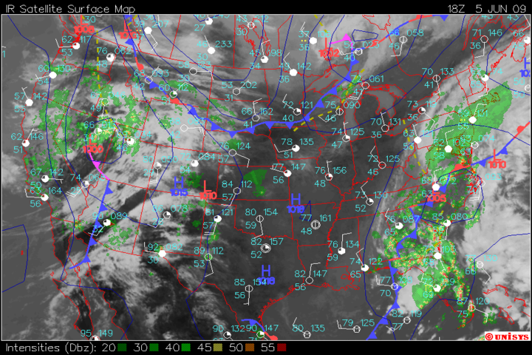
Spice up your videos!
With archive weather data
Tony Perkins
Notes:
Introduction

Slide 2
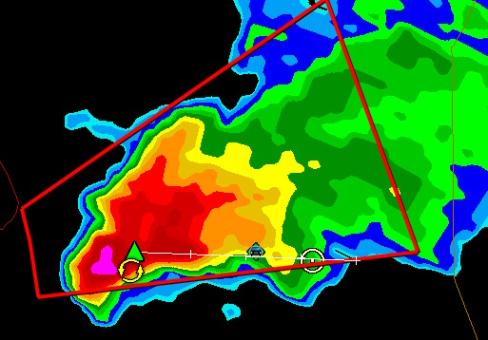
What is archive weather data?
Surface Maps
Radar Images
Your GPS location
Storm reports

Slide 3
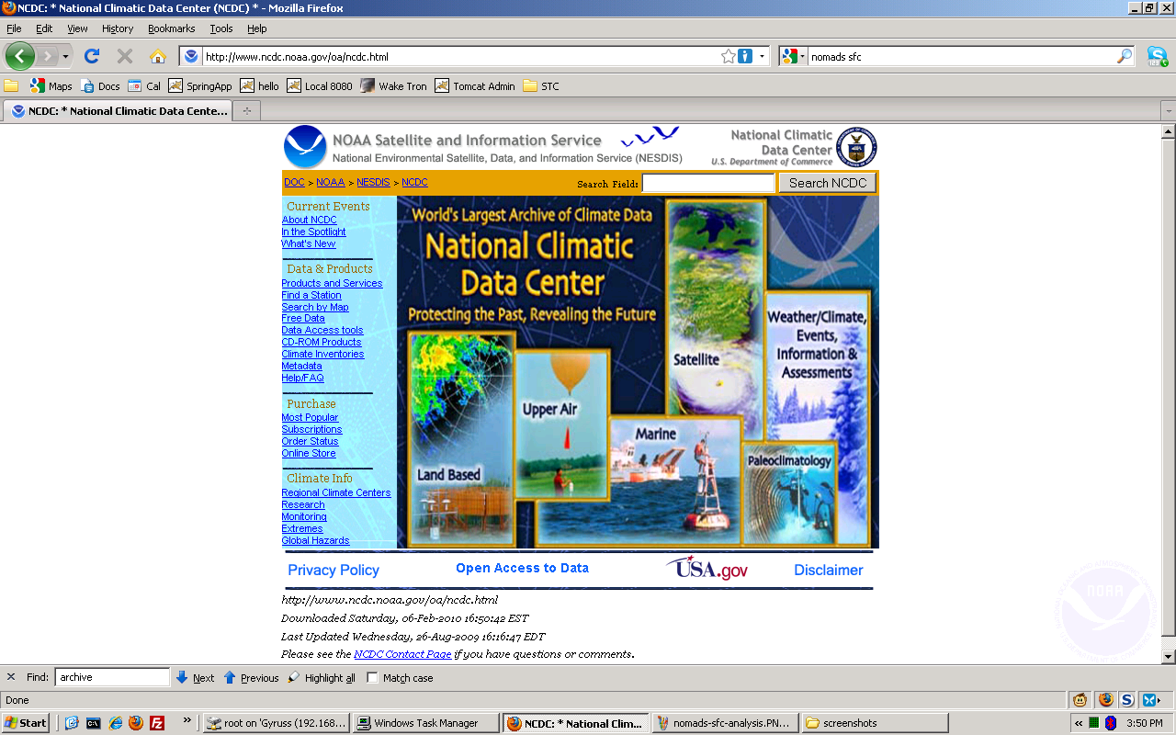
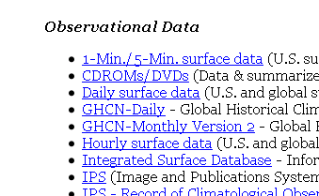
Sources for archive data
NCDC: National Climatic Data Center
http://www.ncdc.noaa.gov
Upper Air
1 and 5 minute METAR
Surface

Slide 4
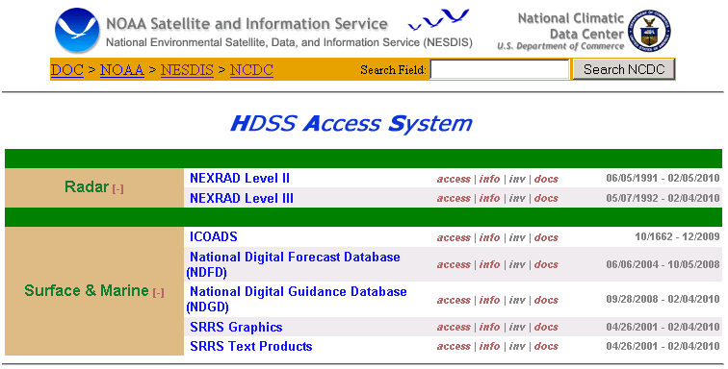
Sources for archive data
HDSS: http://hurricane.ncdc.noaa.gov/pls/plhas/has.dsselect
Level2 and Level3 radar raw data
Text files for everything else

Slide 5
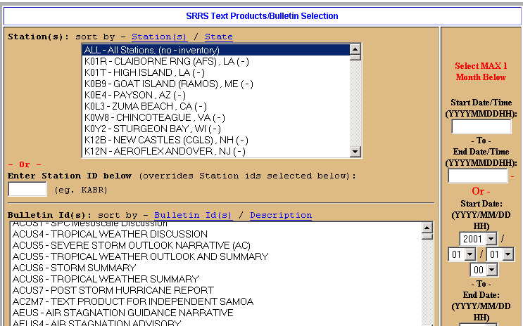
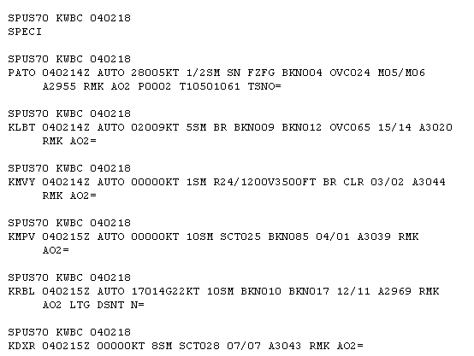
Sources for archive data
SRSS Text Products
Warnings, Volcanoes, METARs, you name it

Slide 6
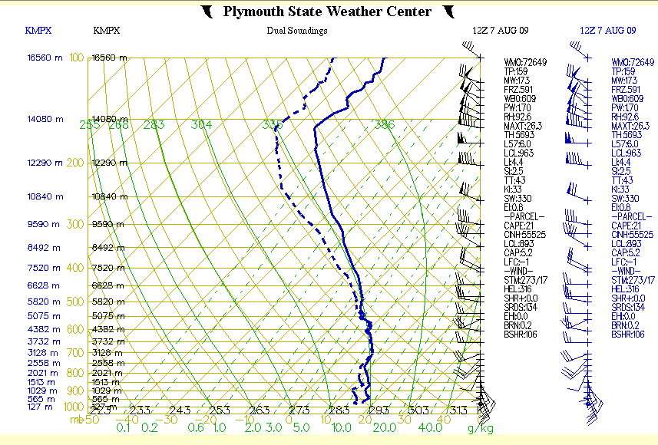
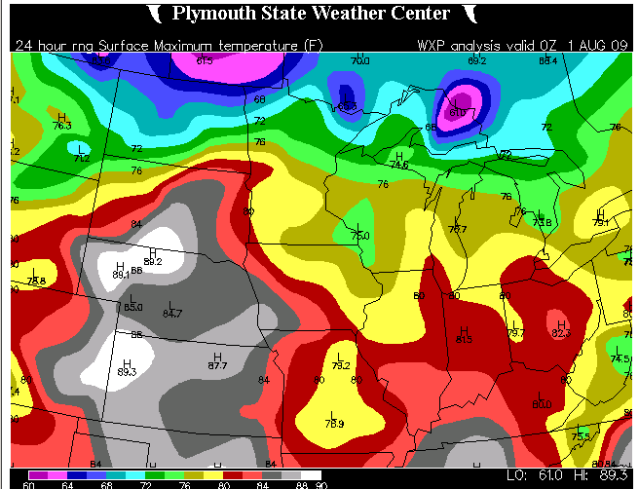
Sources for archive data
Plymouth State: http://vortex.plymouth.edu/u-make.html
Radar Images, Soundings, SFC Maps, Upper Air

Slide 7
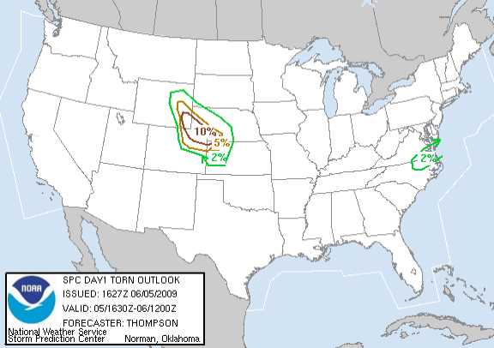
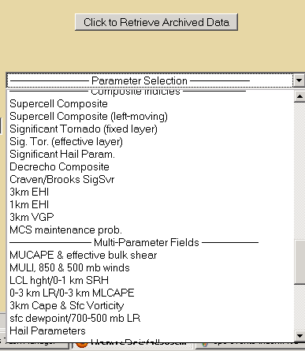
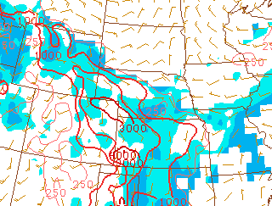
Sources for archive data
Storm Prediction Center: http://www.spc.noaa.gov
Convective Outlooks, Storm Reports
Mesoscale Analysis Images, Mesoscale Discussions

Slide 8
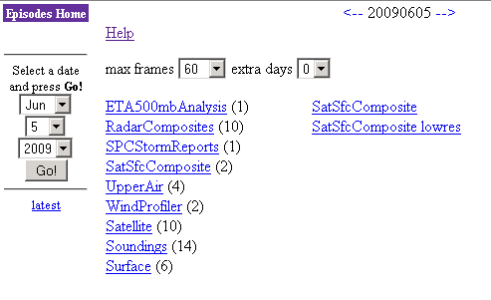
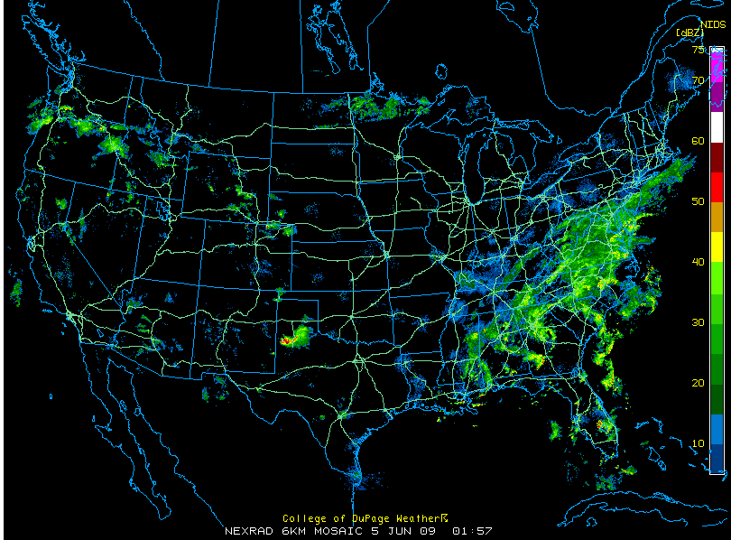
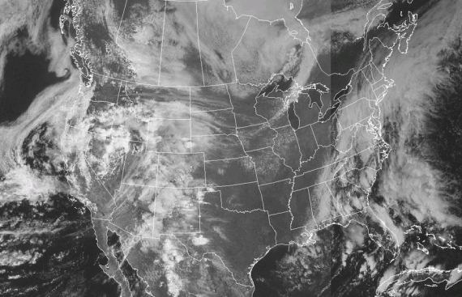
Sources for archive data
UCAR Image Archive: http://www.mmm.ucar.edu/imagearchive
Upper Air, Soundings, Surface Maps (fronts), Satellite

Slide 9
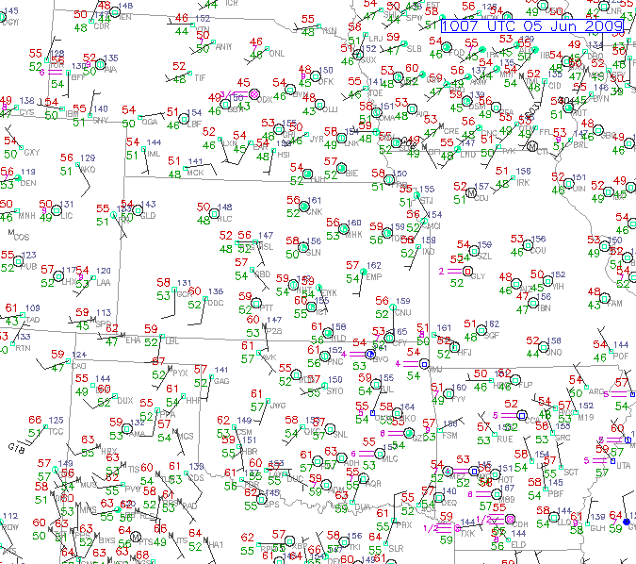
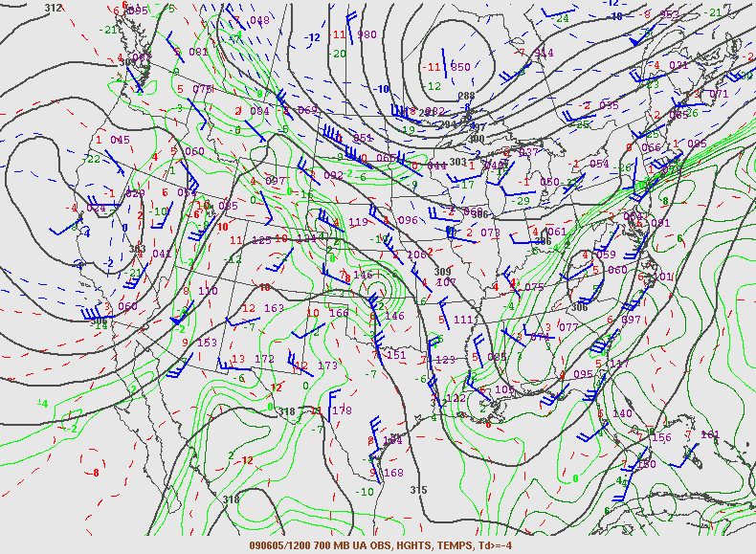
Sources for archive data
More UCAR:

Slide 10
Save sequences of images
Right click on an image and “Save Image As”
Save multiple images to animate later
Surface Analysis Example

Slide 11
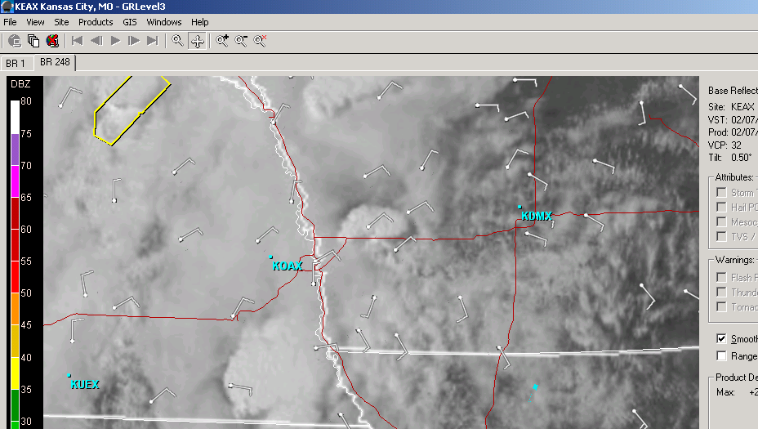
Using GRLevel3
Meant for radar, but makes a decent GIS mapper
Uses “Placefiles” to overlay data on the radar

Slide 12
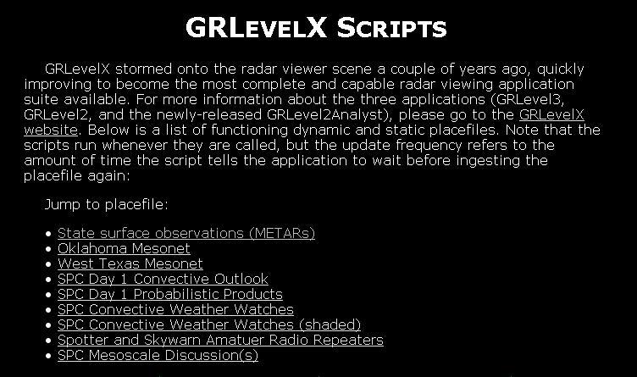
Using GRLevel3
Live data is abundant, but archive is nonexistent
http://grlevel3.tornadocentral.com

Slide 13
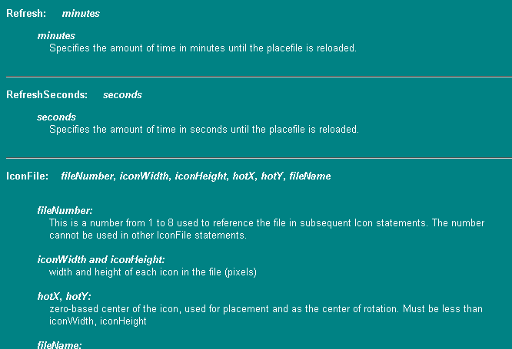
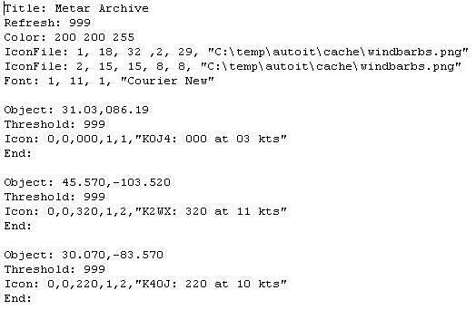
Making placefiles
Look at existing placefiles
Format: http://www.grlevelx.com/manuals/gis/files_places.htm

Slide 14
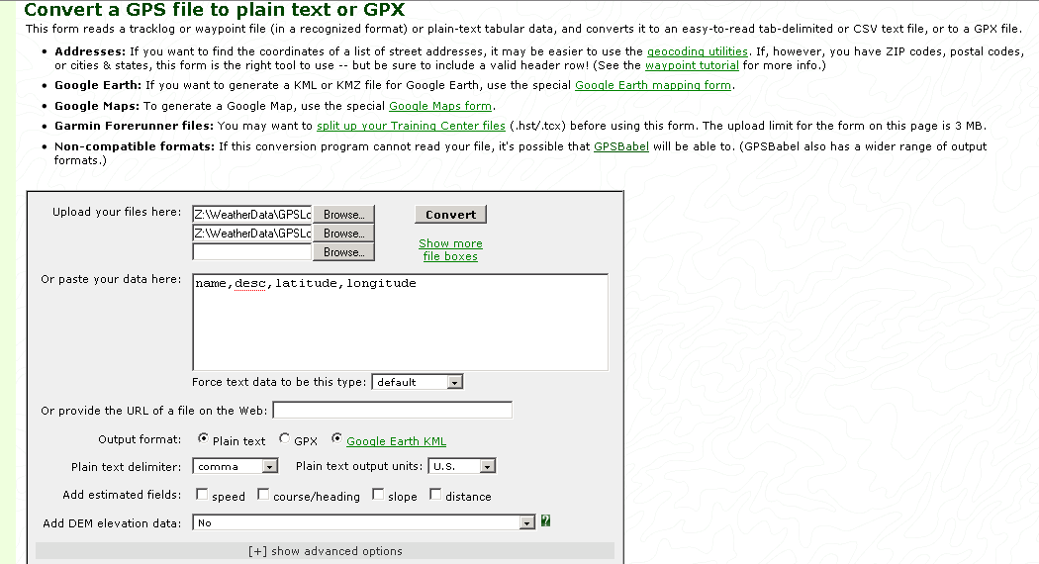
Importing GPS Data
Export your data to a text file
http://www.gpsvisualizer.com/convert_input

Slide 15
Animating Images
Mencoder / FFMpeg: Combine images into a video
http://www.mplayerhq.hu
Imagemagick: Resize images, convert formats.
http://www.imagemagick.org

Slide 16
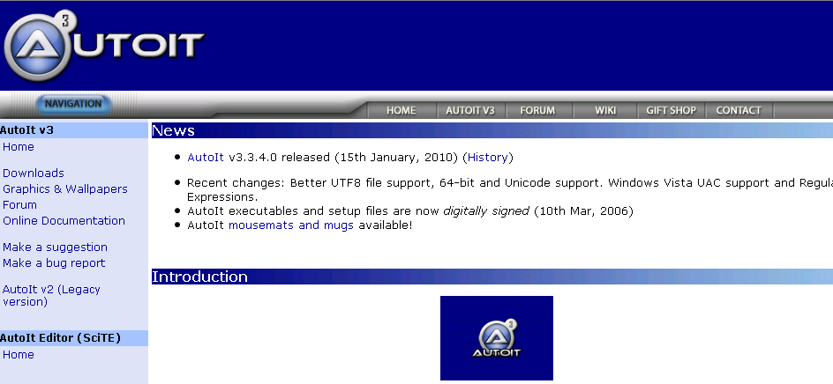
Automation with AutoIT
Free Windows utility to simulate user input
http://www.autoitscript.com/

Slide 17
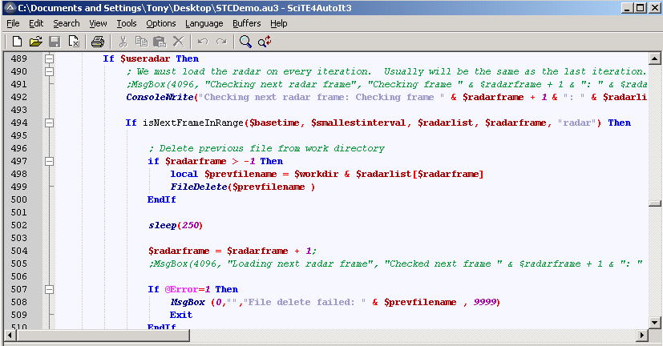
GRLevel3 automation demo

Slide 18
Scripts to make placefiles
Soon available at:
http://blueskybust.com/wxscripts
Movie Time!

